Slide 1


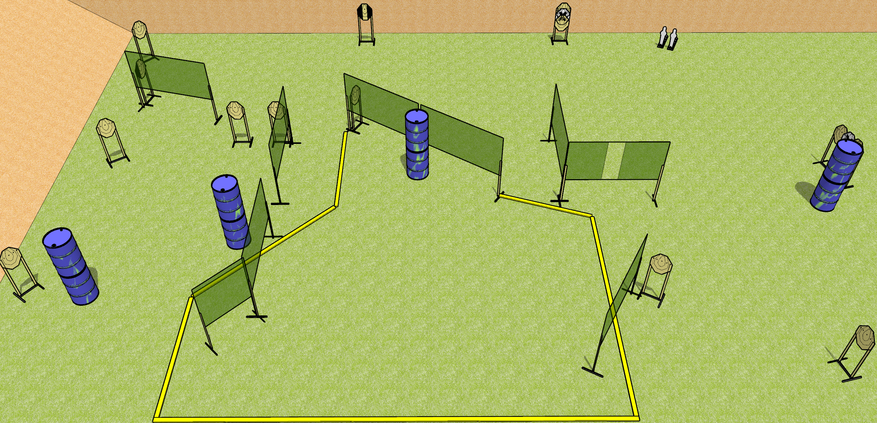
 | Dothan Gun Club – USPSA Match Whatchamacallit Course Designer : Drew Coleman
START POSITION : Standing anywhere completely outside the shooting area, wrists below belt.
GUN READY CONDITION : Pistol loaded and holstered. PCC loaded, safety on, buttstock on belt. |  | SCORING: Comstock, 30 rounds TARGETS: 14 paper, 2 Steel SCORED HITS: Best 2 on paper, steel until down START-STOP: Audible, last shot RULES:
STAGE PROCEDURE: Engage targets as they become available from within the fault lines.

Slide 2
Whatchamacallit
Written Stage Briefing
Whatchamacallit is a 30 round, 150 point, Comstock Field Course. There are fourteen IPSC targets and two mini poppers. The best two hits on paper will score, and steel must fall to score. The start signal is audible.
Handgun start position is standing anywhere completely outside the shooting area, wrists below belt. Handgun is loaded and holstered.
PCC start position is standing anywhere completely outside the shooting area. Carbine is loaded, held with both hands, safety on, buttstock on belt, pointed in a safety direction.
Upon start signal, engage the targets as they become available from within the shooting area.

